Slide 1
World Models
Hao Sun
Mar 2019

Slide 2
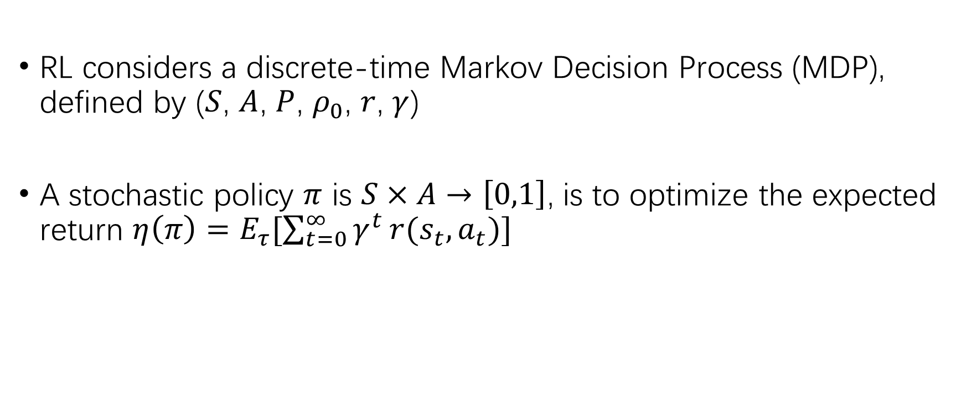
Background: RL
RL considers a discrete-time Markov Decision Process (MDP), defined by ($S$, $A$, $P$, $ρ_{0}$, $r$, $γ$)
A stochastic policy $π$ is $S×A→\left[0,1\right]$, is to optimize the expected return $η\left(π\right)=E_{τ}[\sum_{t=0}^{∞}{γ^{t}}r(s_{t},a_{t})]$

Slide 3
Model-Free/ Model-Based
Model Free (MF): Learning a policy from interactions with the environment directly.
Pros:
Do not rely on models learned but from samples (learn a Q function)
Fast inference
Cons:
Unstable in optimization
Week generalization ability
E.g. REINFORCE, DQN, DDPG, A3C …

Slide 4
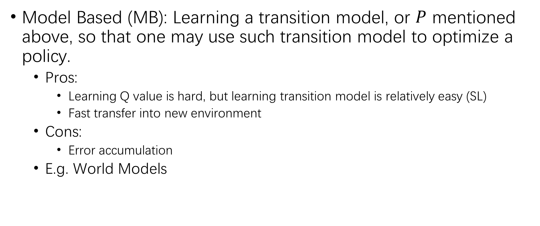
Model-Free/ Model-Based
Model Based (MB): Learning a transition model, or $P$ mentioned above, so that one may use such transition model to optimize a policy.
Pros:
Learning Q value is hard, but learning transition model is relatively easy (SL)
Fast transfer into new environment
Cons:
Error accumulation
E.g. World Models

Slide 5
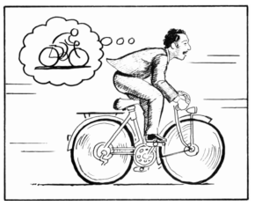
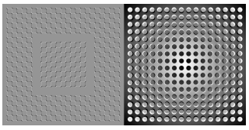
World Models, David Ha, 2018
The image of the world around us, which we carry in our head, is just a model. Nobody in his head imagines all the world, government or country. He has only selected concepts, and relationships between them, and uses those to represent the real system.
-Jay Wright Forrester, the father of system dynamics

Slide 6
A bottleneck of MF
Many MF methods use small neural networks
Bottlenecked by the credit assignment problem
It is hard to learn millions of weights of large models
Details:
MF methods optimize a q-function or q-value estimator, and leverage the trajectory samples collected by running a policy to revise the estimator. (Temporal Difference, TD-methods)
The process is unstable, especially in case of sparse reward problems.

Slide 7
Solution of World Models
Back Propagation methods can be used to train large NN based agents efficiently.
Credit assignment?
Split the problem into two parts:
Learning a world model using VAE and RNN, with large NN
Optimize in the world model using evolution algorithms, with small NN
Model based method

Slide 8
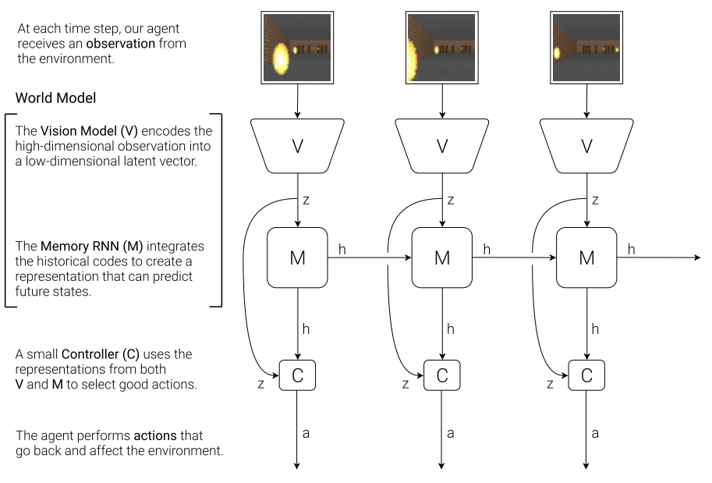
The world Model
Three parts
Vision Model
Memory Model
Controller

Slide 9
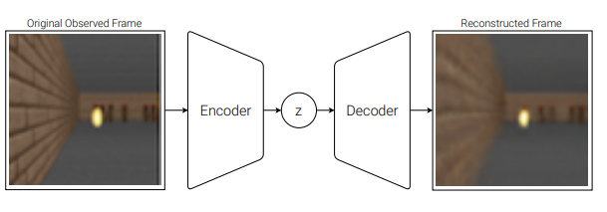
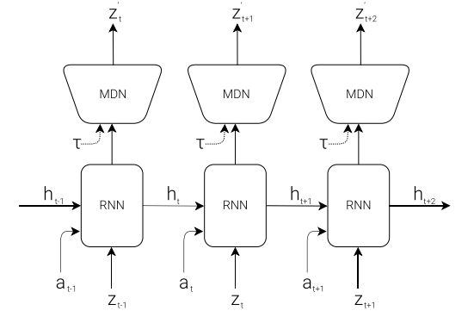

Three parts
Vision Module:
VAE
Memory Module:
RNN (with MDN)
Controller:
$a_{t}=W_{c}\left[z_{t},h_{t}\right]+b_{c}\text{​}$

Slide 10
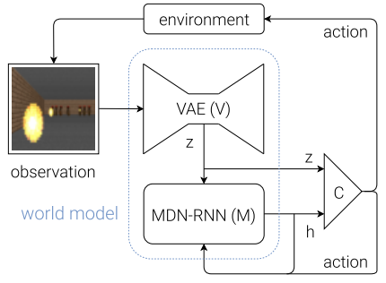
Putting them together
observation-> z
z, a -> h
[z, h] -> a
a -> observation

Slide 11
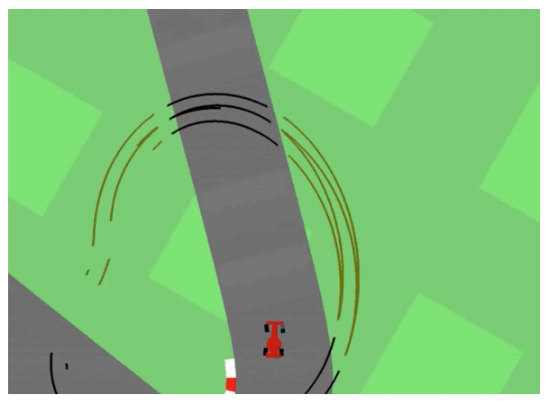
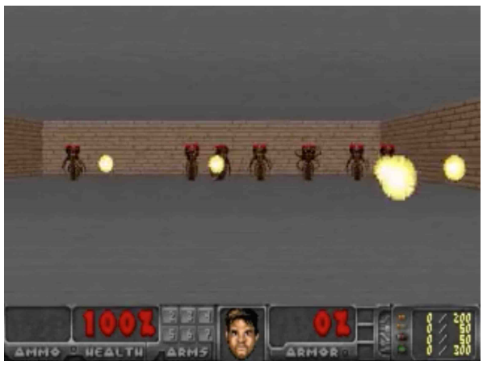
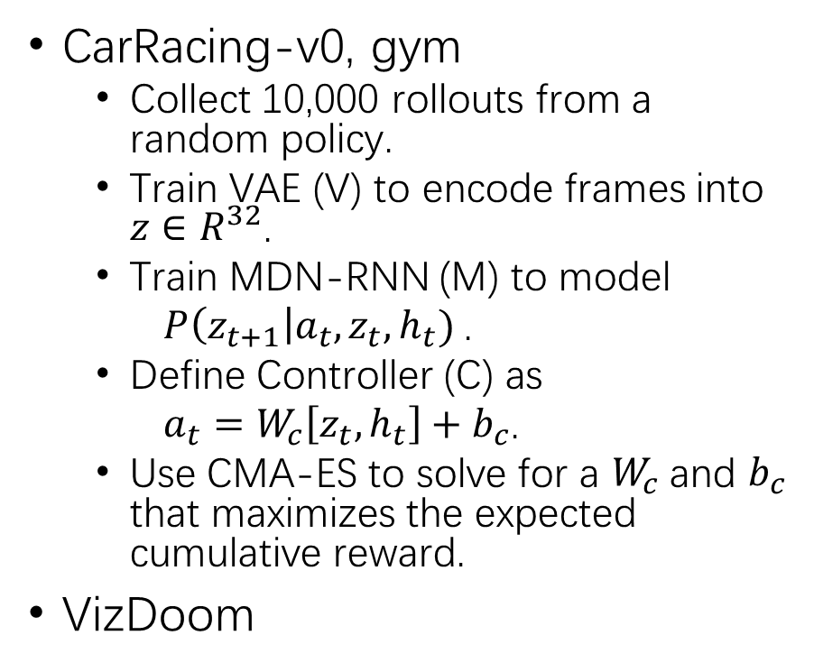
Experiments
CarRacing-v0, gym
Collect 10,000 rollouts from a random policy.
Train VAE (V) to encode frames into $z∈R^{32}$.
Train MDN-RNN (M) to model
$P\left(z_{t+1}\right|a_{t}, z_{t}, h_{t})$.
Define Controller (C) as
$a_{t}=W_{c}\left[z_{t},h_{t}\right]+b_{c}$.
Use CMA-ES to solve for a $W_{c}$and $b_{c}$ that maximizes the expected cumulative reward.
VizDoom

Slide 12
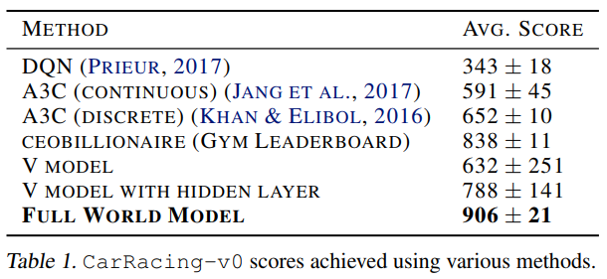
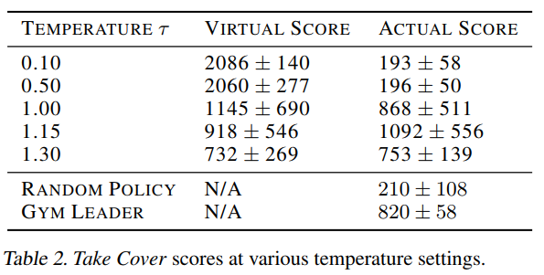
Results
CarRacing
VizDoom

Slide 13
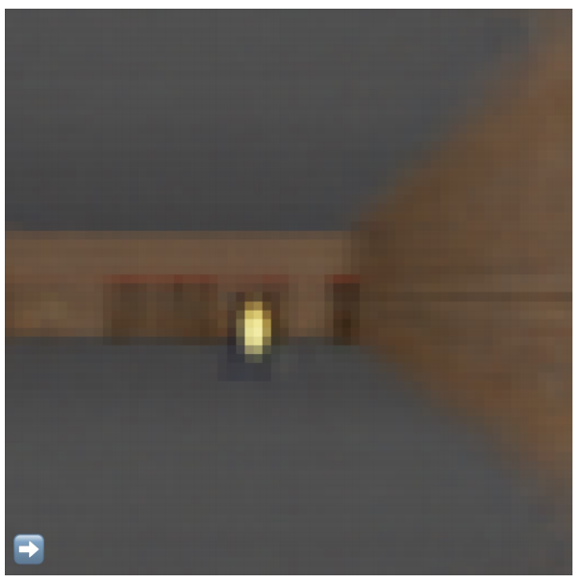
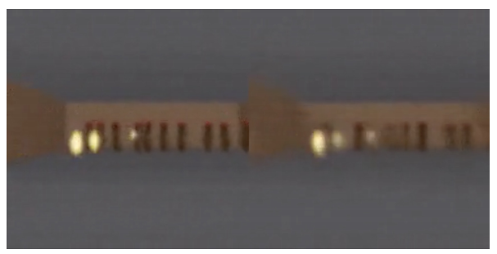
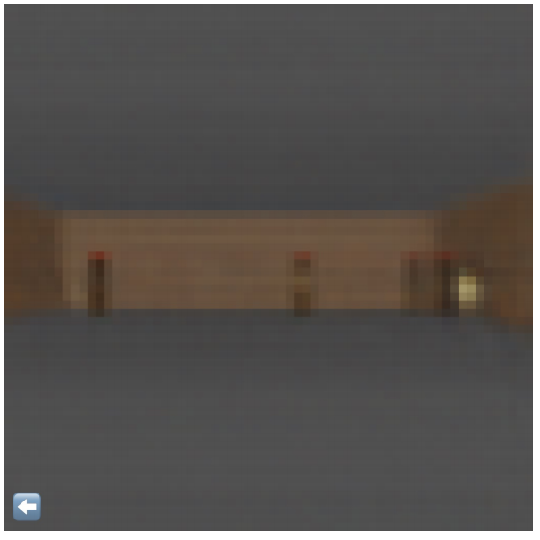
Cheating behaviors
Training inside of the dream
‘Bugs’ of the environment
Iteratively training

Slide 14
References & Extensions
Ha D , Schmidhuber, Jürgen. World Models[J]. 2018.
Hafner D , Lillicrap T , Fischer I , et al. Learning Latent Dynamics for Planning from Pixels[J]. 2018.
https://worldmodels.github.io/
https://planetrl.github.io/

